Slide 1


Oklahoma Indian
Law Update
Surface Use After Osage Wind &
Mineral Fractionation Issues Post-2018 Stigler Act
Speaker:
Lance Walker | Attorney, Oliva Gibbs
Notes:
Good day, everyone! I’m excited to launch today’s session with an Oklahoma Indian Law Update.
Fair warning: this is presentation is scripted to keep me from detouring into, say, the 1898 Atoka Agreement, so we’ll finish on time! Let’s get started.
Justice Clarence Thomas once said in United States v. Lara, ‘Federal Indian policy is, to say the least, schizophrenic,’ and in Oklahoma, that’s an understatement—it’s a legal whirlwind!
Today, we’re tackling two shifts shaking up Indian Country.
First, we’ll explore Surface Use After Osage Wind.
The Osage Wind Farm Cases, culminating in 2024, have flipped our historic understanding of surface versus mineral use, redefining ‘mining’ under federal Indian law and challenging how we approach tribal estates—a shift decades in the making.
Then, we’ll pivot to Mineral Fractionation Issues Post-2018 Stigler Act.
Here, the 2018 Amendments upended 70 years of settled law from the original 1947 Stigler Act, expanding restricted land ownership for the Five Civilized Tribes but unleashing a fractionation crisis, as seen in the Heirs of Noel Pope case filed last November.
While Osage Wind rewrites surface rules and the Stigler Act Amendments remake mineral title, both force us to deal with evolving federal policies as landmen and legal professionals.

Slide 2





Lance Walker
Attorney, Oliva Gibbs
Lance has over two decades of experience advising oil and gas companies across multiple states, bringing valuable knowledge and efficiency to upstream energy title and transactional matters in Oklahoma, Texas, New Mexico, and North Dakota. Prior to settling in Oklahoma City, Lance practiced law in Midland, TX.
405.474.5800
lwalker@oglawyers.com
Connect with Lance on LinkedIn

Slide 3

“Federal Indian policy is, to say the least, schizophrenic.”
— Justice Clarence Thomas

Slide 4

The Osage Wind Farm Cases
Redefining Surface Use in Indian Country
Notes:
First up—the Osage Wind Farm Cases.
These landmark rulings could fundamentally change how we approach surface use on tribal lands, and they carry significant implications for both renewable and traditional energy projects.
As landmen, we’re used to dealing in complex land title issues, but these cases introduce a new layer of diligence that we can’t ignore.
They challenge our assumptions about what constitutes ‘surface work’ and force us to rethink how we interact with tribal mineral estates.
We’ll begin with a foundational look at the Osage Nation’s history, a story of resilience, wealth, and tragedy that sets the stage for these disputes.
Then, we’ll review the regulatory framework for mineral leasing, which is critical to understanding the legal battles that follow.
Next, we’ll examine the three key Osage Wind decisions, focusing on how soil and minerals played a central role in their outcomes.
After that, we’ll consider how these decisions extend beyond Osage County to other tribal lands, including General Allotment Act and Five Civilized Tribes lands, using some practical, real-world examples to bring the implications to life.
Finally, we’ll close with actionable takeaways for our work in the field.
Let’s start with the foundation—the Osage Nation’s remarkable story.

Slide 5
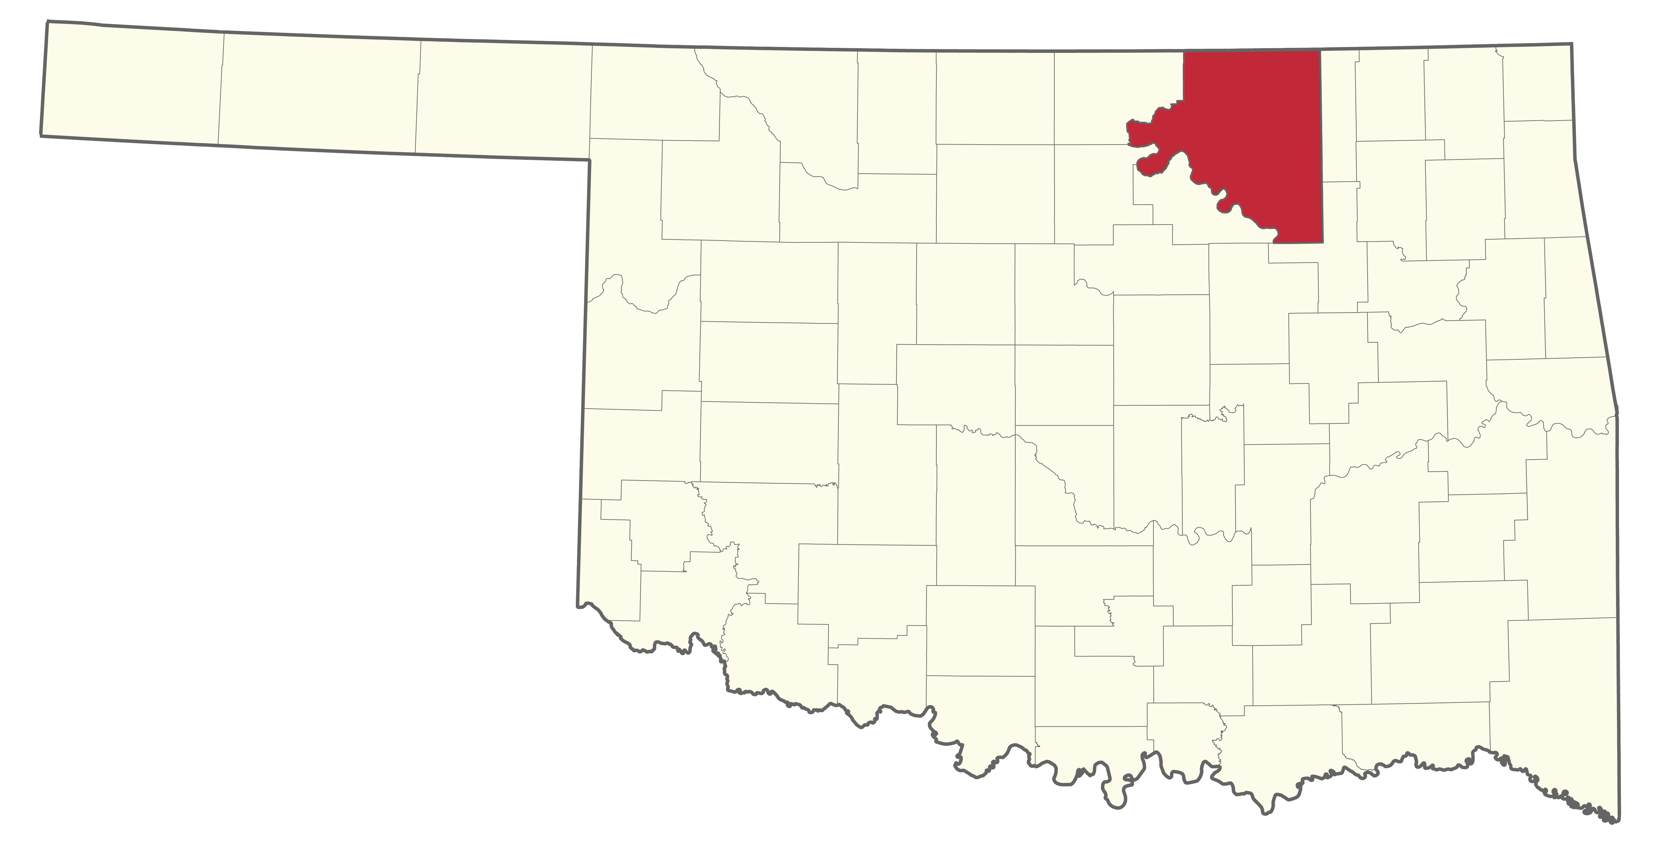
The Osage Nation: Osage County, Oklahoma
1872: Osage purchase 1.5M-acre reservation
1897: Oil discovery transforms economy
1906: Osage Allotment Act reserves mineral estate
1920s: Reign of Terror and legal protections
Notes:
Let’s begin with the Osage Nation’s journey in Oklahoma, starting in 1872 when, after displacement from Missouri and Kansas, they purchased a 1.5-million-acre reservation from the Cherokee Nation, now Osage County.
In 1897, oil discovery triggered an economic boom, making the Osage among the world’s wealthiest by the 1920s—earning $30 million in 1923, equivalent to hundreds of millions today.
The 1906 Osage Allotment Act allocated surface land to individuals but reserved the mineral estate for the tribe, dividing it into inheritable ‘headrights’ that brought immense wealth.
Yet, this prosperity came with tragedy.
In 1921, Congress introduced a guardianship law, deeming any Osage with half or more Indian blood ‘incompetent’ to manage their financial affairs unless proven otherwise in court—a label unrelated to intelligence.
Instead, "competency" was a legal construct, not a reflection of an individual’s actual mental or intellectual capacity.
Guardians, often local lawyers or businessmen, controlled headright payments, providing minimal allowances—$4,000 annually—while pocketing the rest of the headright payments, which often exceeded $10,000 per year in the 1920s.
The guardianship system, while designed to "protect" Osage wealth, became a mechanism for systemic exploitation and contributed directly to the Osage Reign of Terror—a series of murders from 1918 to 1931, targeting Osage individuals for their wealth and headrights.
Outsiders, often through manipulative marriage or guardianship schemes, systematically killed dozens of Osage—some estimates suggest at least 60 and maybe even hundreds—to inherit these lucrative shares.
It granted wealth but took away their independence, leaving the Osage vulnerable.
Congress later restricted headright inheritance to tribal members, but the damage was profound, fostering distrust.
This history of wealth, tragedy, and resilience drives the Osage’s fierce protection of their mineral estate, setting the stage for modern disputes like the Osage Wind Farm Cases.

Slide 6
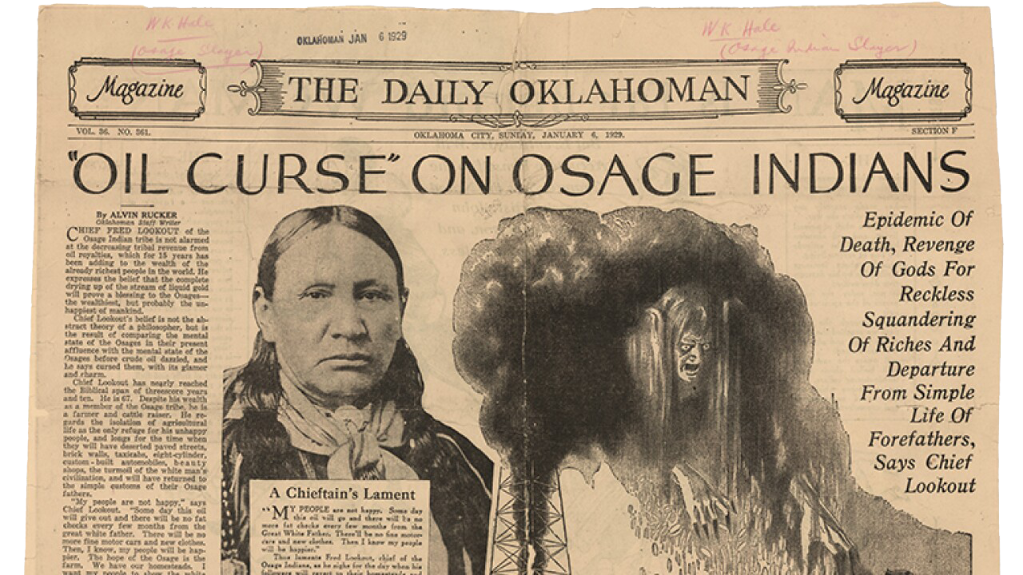
1929: Chief Fred Lookout Reflects on Oil Wealth
Longest serving Osage Chief — 28 years (1913–1949)
Advocated for property interests and mineral estate
“Oil curse” brings wealth but also cultural loss
Predicts a happier future without oil dependency
  Reign of Terror and legal protections
Notes:
Before we explore the regulatory framework, let’s reflect on the perspective of Chief Fred Lookout, a pivotal Osage leader who played a major role in reserving minerals to the tribe and protecting their mineral estate.
Born around 1861 in a Little Osage camp near Independence, Kansas, Chief Lookout walked 150 miles with his family at age ten to the new Osage reservation in 1871, settling in what is now Osage County.
He attended boarding school in Pawhuska, graduated from Carlisle Indian School in Pennsylvania in 1884, and returned to marry Julia Pryor—a great-granddaughter of Chief Pawhuska, the namesake of the Osage County seat. Lookout then settled on a farm near Sand Creek, where he raised his family.
Elected Principal Chief in 1913, he served for 28 years across three terms—until his death in 1949—making him the longest-serving elected chief in Osage history.
A fierce advocate, Chief Lookout frequently traveled to Washington, D.C., to safeguard Osage property interests and oil leases.
He was instrumental in securing amendments to the 1906 Osage Allotment Act, ensuring the tribe’s mineral estate remained protected.
However, despite his influence, Chief Lookout’s life was marked by danger during the Osage Reign of Terror. One story, shared by his great-grandson, Principal Chief Geoffrey Standing Bear, recounts a specific incident where Chief Lookout was driving east of Pawhuska when a bullet shattered his windshield. Neither Pawhuska nor Fairfax, key Osage communities, were safe for Lookout during this violent era.
To protect himself, Chief Lookout took the extraordinary step of hiring bodyguards from Chicago, often described as "gangsters" in family stories. Standing Bear recalls his grandmother’s description:
“They were some guys out of Chicago—they were dressed very nice. And they said, ‘Chief, don’t you worry about a thing from here on! Once everyone learns we’re the ones protecting you, you’re not going to have any problems.’”
These bodyguards provided security for several years--underscoring the failure of local and federal authorities to protect the Osage.
By 1929, amidst the Reign of Terror, Chief Lookout shared a somber reflection in a Daily Oklahoman article titled ‘Oil Curse on Osage Indians.’
He lamented the duality of oil wealth, which had been both a blessing and a curse for his people, saying, ‘My people are not happy… We have our Osage farms, and we can live as the white man lives. I want my people to work for a living.’
Chief Lookout viewed the oil riches as a curse that led to reckless squandering and a departure from the simple life of their forefathers, predicting that the Osage would be happier once the oil ran out, free from dependency.
His leadership and foresight during this era of wealth and tragedy underscore why the Osage remain so protective of their mineral estate.
This protective instinct over resources, championed by leaders like Chief Lookout, is codified in the regulations we’ll examine next.

Slide 7
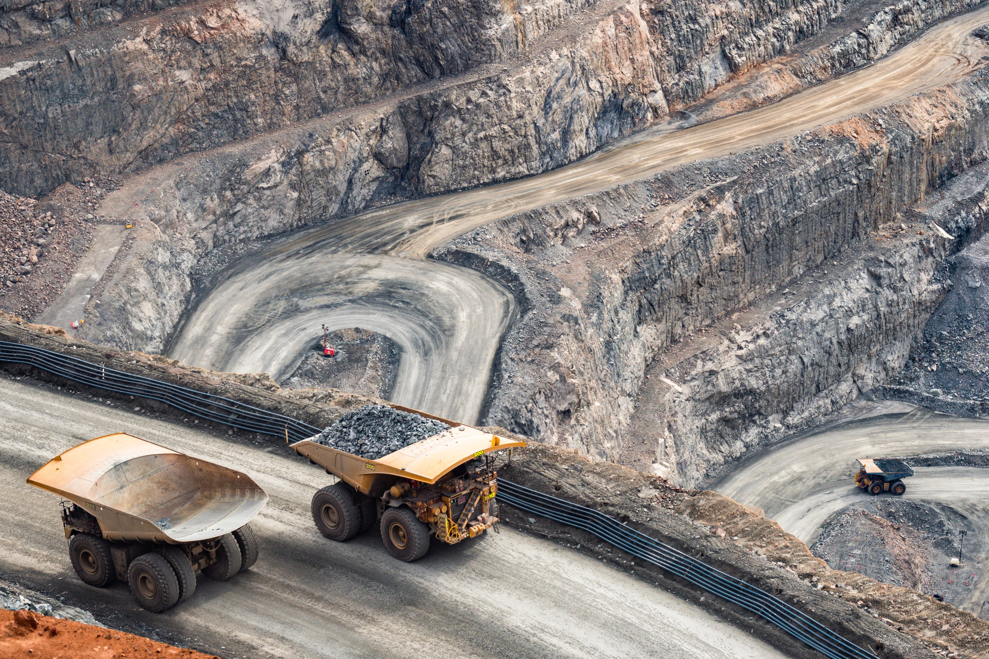
Regulatory Leasing Structure for the Osage
25 C.F.R. § 211: Leasing of Tribal Lands
  Minerals: Includes sand, gravel, pumice, cinders, granite, building stone, limestone, clay, silt, etc.
  Mining: Means the science, technique, and business of mineral development…Excavation
  > 5,000 cubic yards/year for listed minerals
25 C.F.R. § 214: Osage-Specific Leasing
  Aligns with § 211.3 definitions
Notes:
Now, let’s turn to the regulatory framework that governs how the Osage manage their mineral estate, a system that’s critical for understanding the Osage Wind disputes.
Under 25 C.F.R. § 211, which applies to all tribal lands, the definition of ‘minerals’ is intentionally broad—it includes not just oil and gas but also materials like sand, gravel, limestone, and clay, reflecting the diverse resources that tribes control.
‘Mining,’ according to § 211.3, is defined as the science, technique, and business of mineral development, encompassing activities like opencast work, underground work, and even in-situ leaching.
Here’s the key detail for us: for non-energy minerals like gravel, limestone, or clay, an activity is considered ‘mining’ only if you excavate more than 5,000 cubic yards in a given year.
This threshold, as we’ll see, becomes a pivotal benchmark in the Osage Wind cases.
Then we have 25 C.F.R. § 214, which is specific to Osage lands—it aligns with § 211.3’s definitions but tailors them to the Osage Mineral Estate.
This trust relationship ensures that the federal government and the tribe have a say in how these resources are managed, emphasizing the Osage’s authority over their mineral estate.
This regulatory framework isn’t just a set of rules—it’s the backbone of the legal battles we’re about to explore, because it defines what counts as ‘mining,’ who controls it, and why the Osage Wind Farm disputes hinge on these very definitions.

Slide 8

Osage Wind Farm Cases — Overview and
Osage Wind I (2017)
Osage Wind I (2017)
United States v. Osage Wind, LLC, 871 F.3d 1078 (10th Cir. 2017)
  84 turbines; 85,000 acres; 250,000 cubic yards excavated
  Soil/minerals: Clay, limestone crushed into gravel
  Ruling: Excavation = “mining” under § 211.3
Notes:
Let’s turn our attention to the Osage Wind Farm Cases, starting with the first major ruling that set the stage for this legal saga.
In 2010, Osage Wind, LLC leased 8,400 acres of surface rights in Osage County to build a wind farm with 84 turbines.
However, they overlooked a critical detail: they didn’t secure a mineral mining lease, even though the Osage Nation holds the mineral estate.
Construction began in 2013, and the project involved significant excavation—digging pits 10 feet deep and 50 to 60 feet wide, totaling 250,000 cubic yards across all 84 turbines, or about 3,000 cubic yards per turbine.
They excavated clay-rich soil and limestone bedrock, sorted the materials, crushed the limestone into gravel for use as backfill and to stabilize turbine bases and access roads, and then poured concrete over it.
The Osage Minerals Council stepped in, arguing that this process constituted ‘mining’ under federal regulations. In the 2017 case, United States v. Osage Wind, LLC, the Tenth Circuit Court of Appeals agreed. The court applied 25 C.F.R. § 211.3, which defines ‘mining’ as the ‘science, technique, and business of mineral development.’
The court interpreted this broadly, ruling that ‘mineral development’ includes not just traditional extraction for sale but any exploitation of minerals—like excavating, sorting, and crushing limestone for structural use—even if the materials aren’t removed off-site.
The court emphasized that such activities directly impacted the Osage mineral estate, requiring a lease that Osage Wind hadn’t obtained.
This decision overturned the district court’s earlier summary judgment in favor of Osage Wind, setting a new precedent that redefined what ‘mining’ means in this context.
The case was remanded for further proceedings to determine remedies, paving the way for the next chapters in this legal battle.

Slide 9

Osage Wind II (2023) and Osage Wind III (2024)
Osage Wind II (2023)
United States v. Osage Wind, LLC, 710 F. Supp. 3d 1018, 1042-43 (N.D. Okla. 2023)
  60% of material (clay, limestone) used as gravel
  Ruling: Ongoing trespass; turbines must go by Dec. 2025
Osage Wind III (2024)
United States v. Osage Wind, LLC, 2024 U.S. Dist. LEXIS 228482
  Decided on December 18, 2024
  Damages: $309K + $3.8M fees; confirms mining violation
Notes:
The Osage Wind saga continues with two significant rulings that build on the 2017 decision.
In 2023’s Osage Wind II, the U.S. District Court for the Northern District of Oklahoma took a closer look at the project’s impact on the Osage mineral estate.
The court found that 60% of the excavated materials—clay, limestone, and shale—was crushed into gravel and used for backfill and structural support, including stabilizing turbine bases and building access roads across the 8,400-acre site.
This wasn’t a one-time disturbance; it was an ongoing use of tribal minerals without a lease, constituting a continuing trespass on the Osage mineral estate.
The court granted permanent injunctive relief to the Osage Nation and the United States, ordering the ejectment of the wind farm—meaning all 84 turbines must be removed by December 1, 2025.
The court also scheduled a damages trial to determine monetary compensation for the trespass and conversion, building on Osage Wind I’s finding that this was indeed ‘mining’ under federal regulations.
Then, in Osage Wind III in 2024, decided on December 18, the district court delivered its final ruling on remand from the Tenth Circuit.
The court reaffirmed that Osage Wind’s activities—excavating and using limestone, shale, and clay without a lease—violated 25 C.F.R. §§ 211 and 214, which govern tribal and Osage-specific mineral leasing.
The court ordered Osage Wind to pay $242,652 for conversion, $66,780 for trespass, and over $3.8 million in attorneys’ fees and costs to the United States and the Osage Minerals Council, totaling a significant financial penalty.
The removal order from Osage Wind II was upheld, emphasizing the ongoing trespass.
The key takeaway for us? Excavating and repurposing minerals like limestone triggers the ‘mining’ definition under federal regulations—both the volume and the purpose of use matter—and the Osage Act’s trust protection remains a powerful shield for the tribe’s mineral rights.
These rulings don’t just affect Osage County—let’s see how they ripple outward.

Slide 10
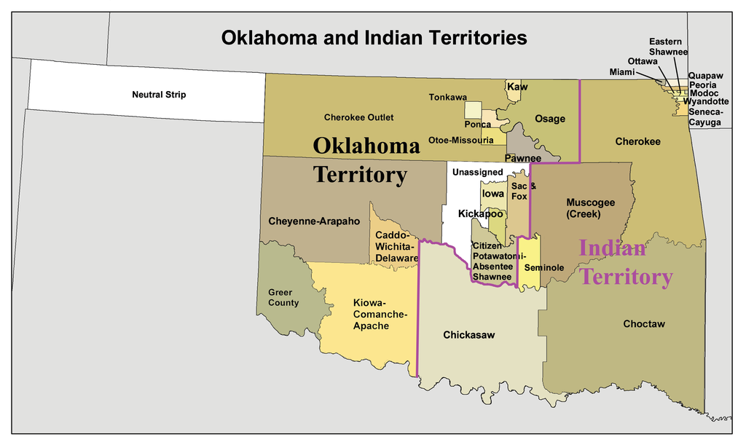
Application to General Allotment & Five Civilized Tribes Lands
25 C.F.R. § 212: Allotted Lands (e.g., Kiowa, Comanche)
  Adopts § 211.3’s mining definition
25 C.F.R. § 213: Five Civilized Tribes (e.g., Cherokee, Creek)
  Aligns with § 211.3; Stigler Act adds oversight
Notes:
So, does the impact of the Osage Wind rulings stop at Osage County?
Not at all—it extends across Oklahoma’s tribal lands, and as landmen, we need to understand how far this precedent reaches.
Under 25 C.F.R. § 212, General Allotment Act lands—like those of the Kiowa, Comanche, or Apache in western Oklahoma—adopt the same § 211.3 definition of ‘mining’ that we saw in the Osage cases.
This means that if you’re excavating over 5,000 cubic yards of materials like sandstone, shale, or gravel—common in the region’s geology—you could be required to secure a mining lease, just as Osage Wind was.
Moving to eastern Oklahoma, 25 C.F.R. § 213 governs the restricted lands of the Five Civilized Tribes—Cherokee, Chickasaw, Choctaw, Creek, and Seminole.
This regulation also aligns with § 211.3’s definition of ‘mining,’ but there’s an added layer of complexity: the 1947 Stigler Act imposes additional oversight. For instance, Section 1 of the Stigler Act requires court approval for any lease on restricted lands, ensuring that conveyances, including oil and gas or mineral leases, are valid only if approved in open court by the district court in the land’s jurisdiction. [now there is some language in the regulations that suggest mining leases need only be approved by BIA]
Additionally, Section 11 subjects these lands to Oklahoma’s oil and gas conservation laws, but any order from the Oklahoma Corporation Commission affecting restricted Indian land must be approved by the BIA.
The Osage Wind logic—that excavation can constitute ‘mining’—could apply across these lands, especially in areas where the geology mirrors Osage County’s limestone, clay, and gravel deposits, as noted by the Oklahoma Geological Survey.
This broader application sets the stage for the practical examples we’ll explore next.

Slide 11

Hypotheticals — Solar, Wind and Oil & Gas
Solar: 10 MW project; 6,250 cubic yards sandstone
Wind: 10 MW (5 turbines); 10,500 cubic yards limestone
Oil & gas: Multi-well pad; 15,763 cubic yards gravel
Notes:
Let’s explore how the Osage Wind precedent applies to other tribal lands with three practical hypotheticals, each reflecting the expanded definition of ‘mining’ under 25 C.F.R. § 211.3, which includes any excavation over 5,000 cubic yards per year of materials like sand, gravel, or limestone.
First, consider a 10-megawatt solar project on General Allotment Act lands in Kiowa County, western Oklahoma, governed by 25 C.F.R. § 212. The region’s geology is rich in sandstone, and this project excavates 6,250 cubic yards of sandstone to build panel foundations, access roads, and infrastructure like substations and trenching.
That exceeds the 5,000-yard threshold, meaning it may require a mining lease, just as Osage Wind did.
For comparison, a smaller 5-megawatt solar project in the same area might only excavate 3,125 cubic yards, falling below the limit—but scale matters, and larger projects like this 10-megawatt one are at risk.
Next, we have a 10-megawatt wind farm near Tahlequah on Cherokee Nation land in eastern Oklahoma, regulated under 25 C.F.R. § 213 and subject to the Stigler Act’s oversight, which requires court approval for leases.
With five turbines at 2 megawatts each, the project excavates 10,500 cubic yards of limestone—common in the region’s geology—for turbine bases and related infrastructure.
That’s well over the 5,000-yard threshold, making it another candidate for a mining lease under the Osage Wind logic.
Finally, let’s look at an oil and gas project in Caddo County, also on General Allotment Act lands.
This multi-horizontal well pad with four lateral lines requires a 400-by-400-foot drilling pad and a 1-mile access road, excavating 15,763 cubic yards of gravel—11,852 for the pad and 3,911 for the road.
That’s significantly above the 5,000-yard limit, and using that gravel onsite for construction mirrors Osage Wind’s actions, likely triggering a mining lease requirement.
For context, a smaller single-well pad in the same area, with a 200-by-200-foot pad and a half-mile road, might excavate 4,919 cubic yards—just under the threshold—but any increase in scope pushes it over.
These examples, spanning renewable and traditional energy projects, show how the Osage Wind Farm rulings could impact our work across Oklahoma’s tribal lands, where geological conditions and regulatory frameworks align with Osage County.

Slide 12

Takeaways for Landmen
Reevaluate surface use agreements
Examine mineral title underlying surface location
Check excavation volumes (>5,000 cubic yards?)
Secure mining leases if needed
Engage Indian mineral owners/BIA early
Notes:
Now, let’s consider what the Osage Wind Farm Cases mean for us as landmen.
These rulings are a clear reminder that our work doesn’t stop at examining surface title—we must also thoroughly investigate the underlying mineral estate, particularly on restricted Indian Allotment lands where minerals like sand, gravel, or limestone are part of the Indian mineral estate.
First, we need to reevaluate our surface use agreements.
The old assumption that excavation is ‘just surface work’ no longer holds—if you’re disturbing minerals over 5,000 cubic yards, as defined by 25 C.F.R. § 211.3, you might need a mining lease, not just a surface deal.
That means checking excavation volumes carefully for materials like sand, gravel, or limestone, because those could trigger lease requirements if they’re tied to the restricted Indian mineral allotments.
To manage this, we should engage with the BIA and/or individual Indian mineral owners early in the project planning phase.
Initiating dialogue upfront helps us understand surface use requirements, secure support, and avoid opposition—or worse, a Federal lawsuit down the road.
Beyond that, it’s critical to conduct thorough legal and regulatory due diligence.
This might involve consulting attorneys who specialize in Native American law to manage title and leasing and ensure compliance with the Osage Wind precedent.
Finally, be prepared to structure your wind or oil and gas leases to address not only surface use but also potential mineral impacts, ensuring they’re legally compliant and respectful of Native mineral interests.
These cases show that mineral rights aren’t just about oil anymore—they’re about dirt, gravel, and how we use them.
It’s a new layer of diligence for us, but by taking these steps, we can manage the risks, keep projects sustainable, and stay on solid ground in our work across Indian Country.

Slide 13

In Conclusion
The Osage Wind Farm Cases redefine surface use—compliance is key!
Notes:
As we conclude, the Osage Wind Farm Cases stand as a pivotal moment—they’re redefining surface use across Indian Country and sending a clear message to us as landmen--that tribal mineral rights are a force to be reckoned with, and compliance is non-negotiable.
For petroleum landmen—it highlights the importance of clear legal frameworks and agreements when operating on Indian Allotted lands, pushing us toward more cautious and collaborative strategies that comply with federal regulations.
Having explored surface use, let’s shift to another challenge reshaping Indian law—mineral fractionation.

Slide 14
Fractionation Woes and a Path Forward
The Heirs of Noel Pope Case
Notes:
As a land professional or anyone tracking Native American mineral rights, you’ve likely encountered the tangled web of fractionation—where mineral interests get sliced into ever-smaller pieces across generations.
A recent case, Heirs of Noel Pope v. United States (Case No. 1:24-cv-01873-KCD), filed in the U.S. Court of Federal Claims, puts this issue front and center.
It’s a story of tiny stakes, big trust disputes, and a federal policy shift that’s both a blessing and a challenge.
Our goal today is to provide a comprehensive analysis for legal and industry professionals.
Let’s begin.

Slide 15
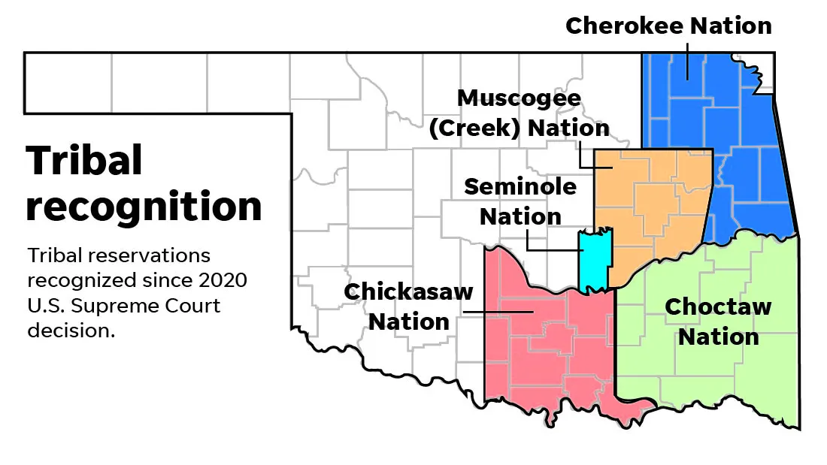
Case Overview
Case: Heirs of Noel Pope v. United States, Case No. 1:24-cv-01873-KCD, U.S. Court of Federal Claims, filed Nov. 14, 2024
Origin: In the Matter of the Approval of Oil and Gas Leases, Pittsburg County, OK, Case No. FB-2022-1, June 22, 2022
Plaintiffs: 16 descendants of Noel Pope (Choctaw, Roll No. 9004)
Lease Terms: $502/acre bonus; 3/16 royalty; 3-year term
Claims: Breach of trust (3 counts), unconstitutional taking, illegal extraction
Notes:
The plaintiffs—16 descendants of Noel Pope, an enrolled full-blood Choctaw—own or stand to inherit fractional mineral interests in an 80-acre allotment in Pittsburg County, Oklahoma, granted in 1903.
This restricted-fee land, governed by federal statutes for the Five Civilized Tribes, has seen oil and gas activity since at least 1930.
The latest chapter unfolded on June 22, 2022, when the District Court of Pittsburg County, in In the Matter of the Approval of Oil and Gas Leases by Restricted Indian Heirs of Noel Pope (Case No. FB-2022-1), approved oil and gas leases under the provisions of the 1947 Stigler Act, as amended in 2018.
The terms? A $502-per-acre bonus and a 3/16 royalty for a three-year primary term.
But here’s the rub: of 84 listed mineral owners, only 20—those who signed a lease (or who otherwise made arrangements)—received bonus payments.
The remaining 64, including “Non-Consenting Plaintiffs,” got nothing.
The plaintiffs allege the United States breached its trust duties in three ways:
1. Failing to represent them adequately during the lease process,
2. neglecting to ensure payments for all owners, and
3. mismanaging oil and gas proceeds.
They also claim an unconstitutional taking or illegal extraction under the Fifth Amendment, arguing their mineral rights were exploited without compensation.

Slide 16
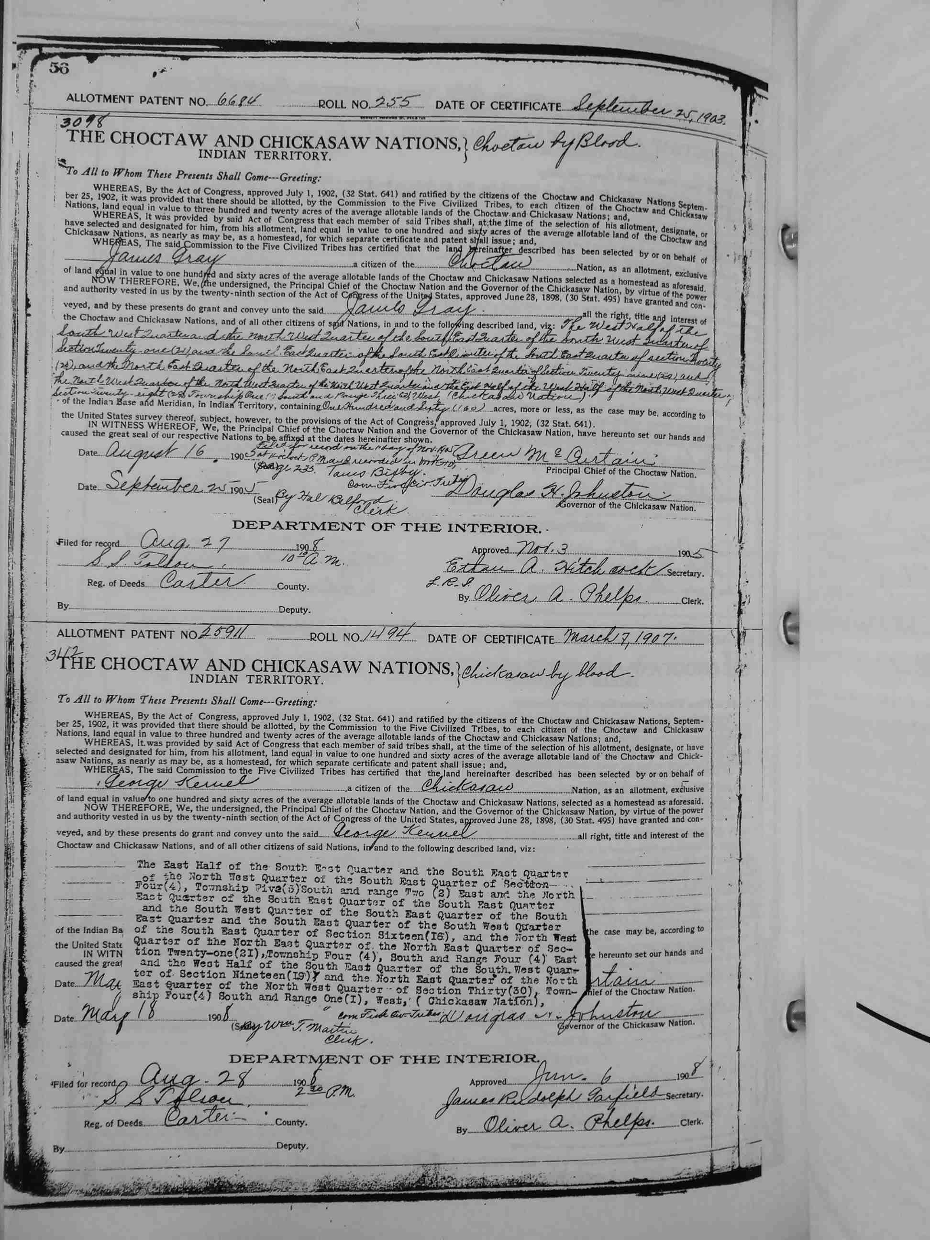
Stigler Act of 1947
Enacted: Aug. 4, 1947 (61 Stat. 731)
Purpose: Regulate Five Tribes’ restricted lands (Cherokee, Choctaw, etc.)
  Provisions:
    ½ Indian blood to retain restrictions on transfers
    State court jurisdiction (probate, leases) with BIA oversight
    OCC oil/gas authority, BIA approval of OCC Orders required
  Impact: Reduced federal burden, increased land loss via tax sales
Notes:
Enacted in 1947, the Stigler Act aimed to streamline the management of restricted lands held by members of the Five Civilized Tribes.
Before then, federal courts were bogged down with probate, quiet title, and lease approval cases for these allotments—originally granted in fee but restricted against alienation (think title transfers) without federal oversight.
The Act shifted these duties to Oklahoma state courts, supervised by the Bureau of Indian Affairs (BIA), and granted the Oklahoma Corporation Commission (OCC) regulatory authority over oil and gas activities, subject to BIA approval of all OCC Orders. (pooing and spacing orders, ect.)
A key provision tied restricted status to blood quantum: heirs needed at least one-half degree Indian blood to maintain restrictions; otherwise, the land became unrestricted, taxable, and freely transferable.
This framework reduced federal burdens but came at a cost.
Over decades, lands slipped out of restricted status—often through tax sales or dubious transfers—eroding individual tribal member holdings.
The blood quantum rule, misaligned with the Five Tribes’ membership criteria (which lack such thresholds), exacerbated this loss, a point underscored in the legislative history of the 2018 Stigler Act Amendments (Senate Report 115-398).

Slide 17
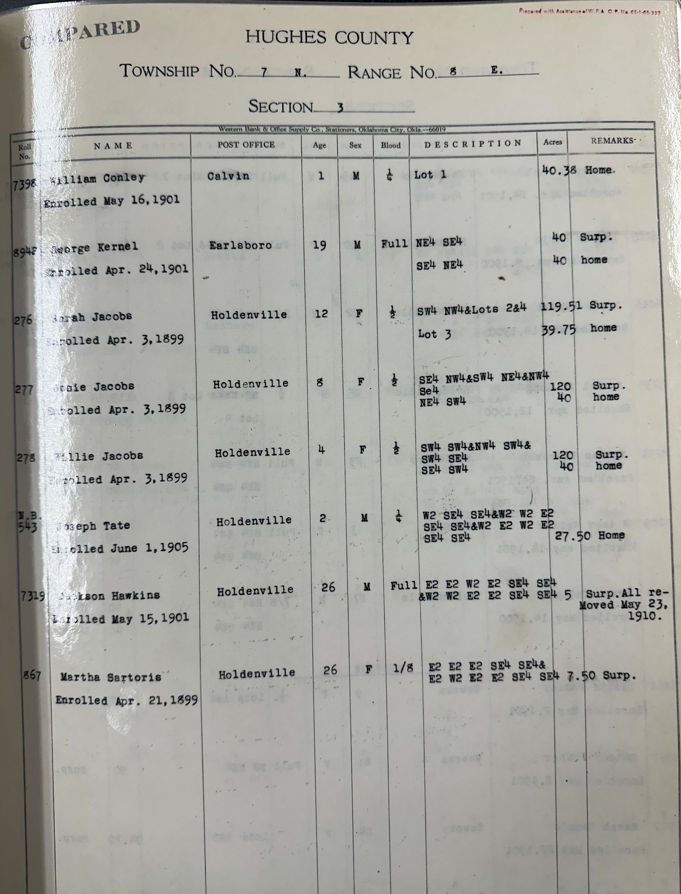
2018 Stigler Act Amendments
Enacted: Dec. 31, 2018 (Public Law 115-399, 132 Stat. 5331)
Change: Eliminated blood quantum; restrictions for all lineal descendants
Intent: Preserve tribal lands, align with Five Tribes’ criteria (Senate Report 115-398)
Outcome: Increased heir pool, intensified fractionation
Lease process: State court approval retained
Notes:
The 2018 Amendments sought to stem this tide. Signed into law on December 31, 2018 (Public Law 115-399), they eliminated the blood quantum requirement, extending restricted status to all lineal descendants of original enrollees.
The intent was clear: preserve tribal land for cultural and economic integrity, aligning Five Tribes’ treatment with other Native groups where restricted status persists regardless of heritage.
Yet, this reform had a double-edged effect. By broadening eligibility, it swelled the pool of restricted interest holders, intensifying fractionation.
The Heirs of Pope case exemplifies this: more heirs, smaller shares, and a tangle of economic and legal challenges.
In other words, by widening the pool of restricted heirs, it’s supercharged fractionation. More owners mean smaller slices.

Slide 18
Fragmented Mineral Interest
Summary Table with Total Net Acres
16 Plaintiffs
1.244 net acres in the 80-acre allotment
Notes:
The root of this mess? Fractionation.
At its core, this case is a microcosm of fractionation’s fallout.
Their lawsuit argues the U.S. failed its fiduciary role—whether by not representing them properly during lease approval, ensuring payments for all, or managing funds.
However, the 16 plaintiffs collectively hold just 1.244 net acres—less than 2% of the 80-acre allotment.
Their individual stakes range from 0.020000 acres (Alfred Lee Pope III) to 0.236000 acres (Robin Lynn Starr, per one record).
This fragmentation, amplified by 2018 policy shifts, sets the stage for our deeper look.

Slide 19
Fractionation Quantified
Based on 80-acre allotment:
  Mary Pope: 1/528 = 0.151515 net acres
  Robin Lynn Starr: 7/2376 = 0.235690 net acres
  Alfred Lee Pope III: 1/3960 = 0.020202 net acres
Total: 1.244 net acres across 16 plaintiffs, leaving 78.756 acres with other owners
Notes:
Fractionation’s scale is evident in the plaintiffs’ mineral interest.
Based on an 80-acre allotment, Mary Pope, for example holds 0.151200 net acres from a 1/528 mineral interest.
Robin Lynn Starr holds the largest interest—0.236000 nets acres—while Alfred Lee Pope III has the smallest interest at 0.020000 net acres.
Together, the 16 plaintiffs own 1.244 net acres, as shown in a prior slide, leaving 78.756 acres with other folks.
This extreme division highlights the challenge of managing such minute interests.

Slide 20
The Economic Reality of Tiny Interests
640-acre unit, 3/16 royalty (0.1875)
  Mary Pope: 0.00004439 revenue interest; $25 = $563,200
  Alfred Lee Pope III: 0.00000592 revenue interest; $25 = $4.224 Mil.
Pittsburg County Well
  50 barrels of oil daily (at $50/barrel = $2,500) and 300 MCF of gas (at $3/MCF = $900), totaling $3,400/day.
Time for $25
  Mary: 166 days (5.5 months)
  Alfred: 1,255 days (3.4 years)
Notes:
Now, place these interests in a 640-acre drilling and spacing unit—with a 3/16 royalty.
The decimal revenue interest (net acres / 640 × 3/16) reveals their share of production revenue:
o Mary Pope: 0.00004439. (starts at the 5th decimal)
o Alfred Lee Pope III: 0.00000592. (starts at the 6th decimal)
So, how much production revenue delivers a modest $25 royalty check? Well, divide $25 by these decimals:
o Mary Pope: $563,200 in production revenue needed, to get $25 in royalty.
o Alfred Lee Pope III: $4.224 Million in production revenue needed, just to get a $25 check.
So how long would it take for a well to produce enough revenue to generate a $25 royalty?
Well, historically Pittsburg County is a noted gas producer, so it leans heavily on natural gas over oil.
Based on regional averages, a horizontal well might, for example, yield 50 barrels of oil daily ($50/barrel = $2,500) and 300 MCF of gas ($3/MCF = $900), totaling $3,400/day.
At this rate:
o Mary Pope: $564,145 / $3,400 ≈ 166 days (5.5 months to get to $25 royalty).
o Alfred Lee Pope III: $4,266,667 / $3,400 ≈ 1,242 days (3.4 years to get to $25 royalty).
If oil production drops to 10 barrels/day ($1,400/day total), timelines stretch to 13 months and 8.3 years, respectively.
These figures assume steady output and prices—real-world declines and market swings could extend them further.
For such small stakes, the wait (and litigation) hardly seems worth it, spotlighting fractionation’s practical absurdity.

Slide 21

Economic Disincentives of Small Interests — Complexity and Time
Small interests
  Mary Pope: 0.151200 net acres ($25 = 563,200 production)
  Alfred Lee Pope III: 0,020000 net acres ($25 = $4.224 Mil production)
Management burdens
  Title examination: Extensive heirship tracing (landman + lawyer)
  Lease prep & court approval: Drafting, filings, Stigler Act hearings
  Operator accounting: Tracking tiny royalty shares
  Months to years for title clearance, lease approval
Time
  Months to years for title clearance, lease approval
Notes:
Considering the economic reality of these small interests—Managing them is a Herculean task.
Title examination requires landmen and lawyers to untangle decades of heirship, a process fraught with title traps due to fractionation.
Lease preparation and Stigler Act court approvals involve drafting, filings, and hearings—each step a time sink.
Operators must then account for minuscule royalty shares, adding to ongoing effort.
From title examination to lease execution, this can stretch over months or years, far outpacing the modest revenue potential.

Slide 22

Economic Disincentives — Risks and Consequences
Additional challenges
  Business risk: Lease void if Stigler Act compliance fails
  Plaintiff burden: Hearing attendance, litigation (e.g., Heirs of Pope)
Outcome: Effort and risk exceed value
  $25 royalty vs. prolonged, uncertain process
Consequence: Operators avoid restricted lands
2018 Amendments: Fractionation surge deters development
Notes:
The challenges escalate with risks.
Operators face a significant business hazard: if Stigler Act approvals falter, leases can be declared void, nullifying investments.
For mineral owners, attending hearings and pursuing litigation—demand substantial commitment, as seen in Heirs of Pope case.
Effort and uncertainty dwarf the revenue potential, rendering development impractical.
The result? Operators often bypass restricted Indian lands, avoiding the headache.
This is an unintended consequence of the 2018 Amendments: by expanding fractionation, it’s made development uneconomical for some Operators, stalling the very lands it aimed to protect.

Slide 23
A Path Forward — Recognizing Fractionation
Trust Duty Context
  U.S. v. Mitchell, 463 U.S. 206 (1983)
  American Indian Trust Fund Management Reform Act (25 U.S.C. §§ 4001-4061
BIA’s response: Division of Trust Land Consolidation (DTLC)
  Targets General Allotment Act lands (Western Oklahoma)
  Consolidates fractional interests into tribal trust
Limitation: Excludes Five Civilized Tribes’ Stigler Act Lands
Notes:
The Heirs of Noel Pope plaintiffs allege a breach of trust, rooted in cases like U.S. v. Mitchell and the American Indian Trust Fund Management Reform Act, spotlighting the U.S.’s duty to manage Indian lands fairly.
The BIA has long recognized fractionation as a trust issue—where inherited interests shrink to unworkable slivers—and launched the Division of Trust Land Consolidation program, to address it.
Stemming from the Cobell settlement and the Indian Land Consolidation Act, the program buys fractional interests from willing Indian sellers under the General Allotment Act, like those of the Kiowa or Cheyenne, consolidating them into tribal trust ownership to boost sovereignty and usability.
It’s a proactive fix, reducing co-owners from dozens to one tribal entity.
But here’s the catch: it’s tailored for trust lands from the 1887 General Allotment Act, not the restricted fee lands of members of the Five Civilized Tribes under the Stigler Act.
The Heirs of Pope case, tied to Choctaw allotments and the 2018 Amendments, falls outside this scope—its state-court framework and unique history don’t align with the federal buy-back model.
So, where does that leave us? Let’s explore a path that does fit.

Slide 24

A Path Forward – State Pooling for
Five Tribes
Oklahoma Force Pooling: 52 O.S. § 87.1
BIA authority: Approve OCC pooling orders (Stigler Act; 25 CFR § 211.3 – “best interest of the Indian mineral owner” standard)
Current practice: BIA prefers unit agreements
Issue: Regulatory hurdles deter operators
Solution: Pooling fits Five Tribes’ restricted lands
Notes:
For the Five Civilized Tribes, the buy-back program mismatch leaves a gap, but Oklahoma’s force pooling statue [52 O.S. § 87.1] offers a viable path.
The Stigler Act empowers the BIA to approve Oklahoma Corporation Commission pooling orders, guided by 25 CFR § 211.3’s ‘best interest of the Indian mineral owner’ standard—balancing economic gain, marketability, and cultural impacts.
Unlike the federal buy-back program’s focus on General Allotment Act trust lands, pooling suits the Five Tribes’ restricted fee lands, integrating with their state-court lease approval process, as seen in Heirs of Pope.
Yet, the BIA often favors unit agreements—marked by lengthy negotiations and inconsistent approvals—that bog down development and deter operators, hinting at a trust duty shortfall.
Pooling, by contrast, streamlines participation: it forces all owners into a unit, ensuring even tiny interests, like the Pope heirs’ 1.244 acres, share proceeds without voluntary sales or federal buy-backs.
It’s a practical fix where the but-back program can’t reach, aligning with the Stigler Act’s framework and Oklahoma’s oil and gas laws.
By easing regulatory hurdles, it could turn fractionation from a burden into an asset, honoring the trust duty where current practices falter.
Let’s see why this works for Indian owners.

Slide 25

Benefits of Pooling for Indian Owners
Advantages
  Fair market value: Options reflect current rates (e.g., 19.75% royalty + bonus)
  Flexibility: New elections with each unit size change (e.g., 12.5% to 18.75%)
  Legal protections: Implied covenant to market (no pre-market deductions)
  Equity: All owners share proceeds, consenting or not
Trust alignment
  Funds to IIM accounts (25 CFR § 115.702)
Notes:
Why does pooling suit Five Tribes’ restricted mineral owners?
First, it ensures fair market value for drilling rights.
Modern pooling orders offer unleased owners multiple options on a graduated scale—for example say, a:
1. 1/8 royalty with a $2,000 per acre bonus,
2. 3/16 royalty with $1,500 bonus,
3. 20% royalty with $1,000, or a
4. 25% royalty with no cash bonus.
Second, it’s flexible: if a unit grows from 160 to 640 acres, owners get new elections, under a new pooling--adjusting royalty terms like 12.5% to 20%—a flexibility traditional oil and gas leases lack.
Third, legal protections kick in: the implied covenant to market, now embedded in Oklahoma’s pooling rules, prohibits royalty deductions for production costs like gathering, compression or transportation needed to make gas marketable, safeguarding royalties.
Also, by directing proceeds to Individual Indian Money (IIM) accounts per federal regulation [25 CFR § 115.702], pooling would fulfill the BIA’s trust duty to manage funds effectively for all owners.
Unlike the buy-back programs’s focus on General Allotment Act consolidation, pooling fits the Five Tribes’ restricted lands, turning tiny mineral interests into viable revenue without requiring owners to sell out.
It’s a trust-aligned solution for Oklahoma’s unique Indian law landscape.

Slide 26
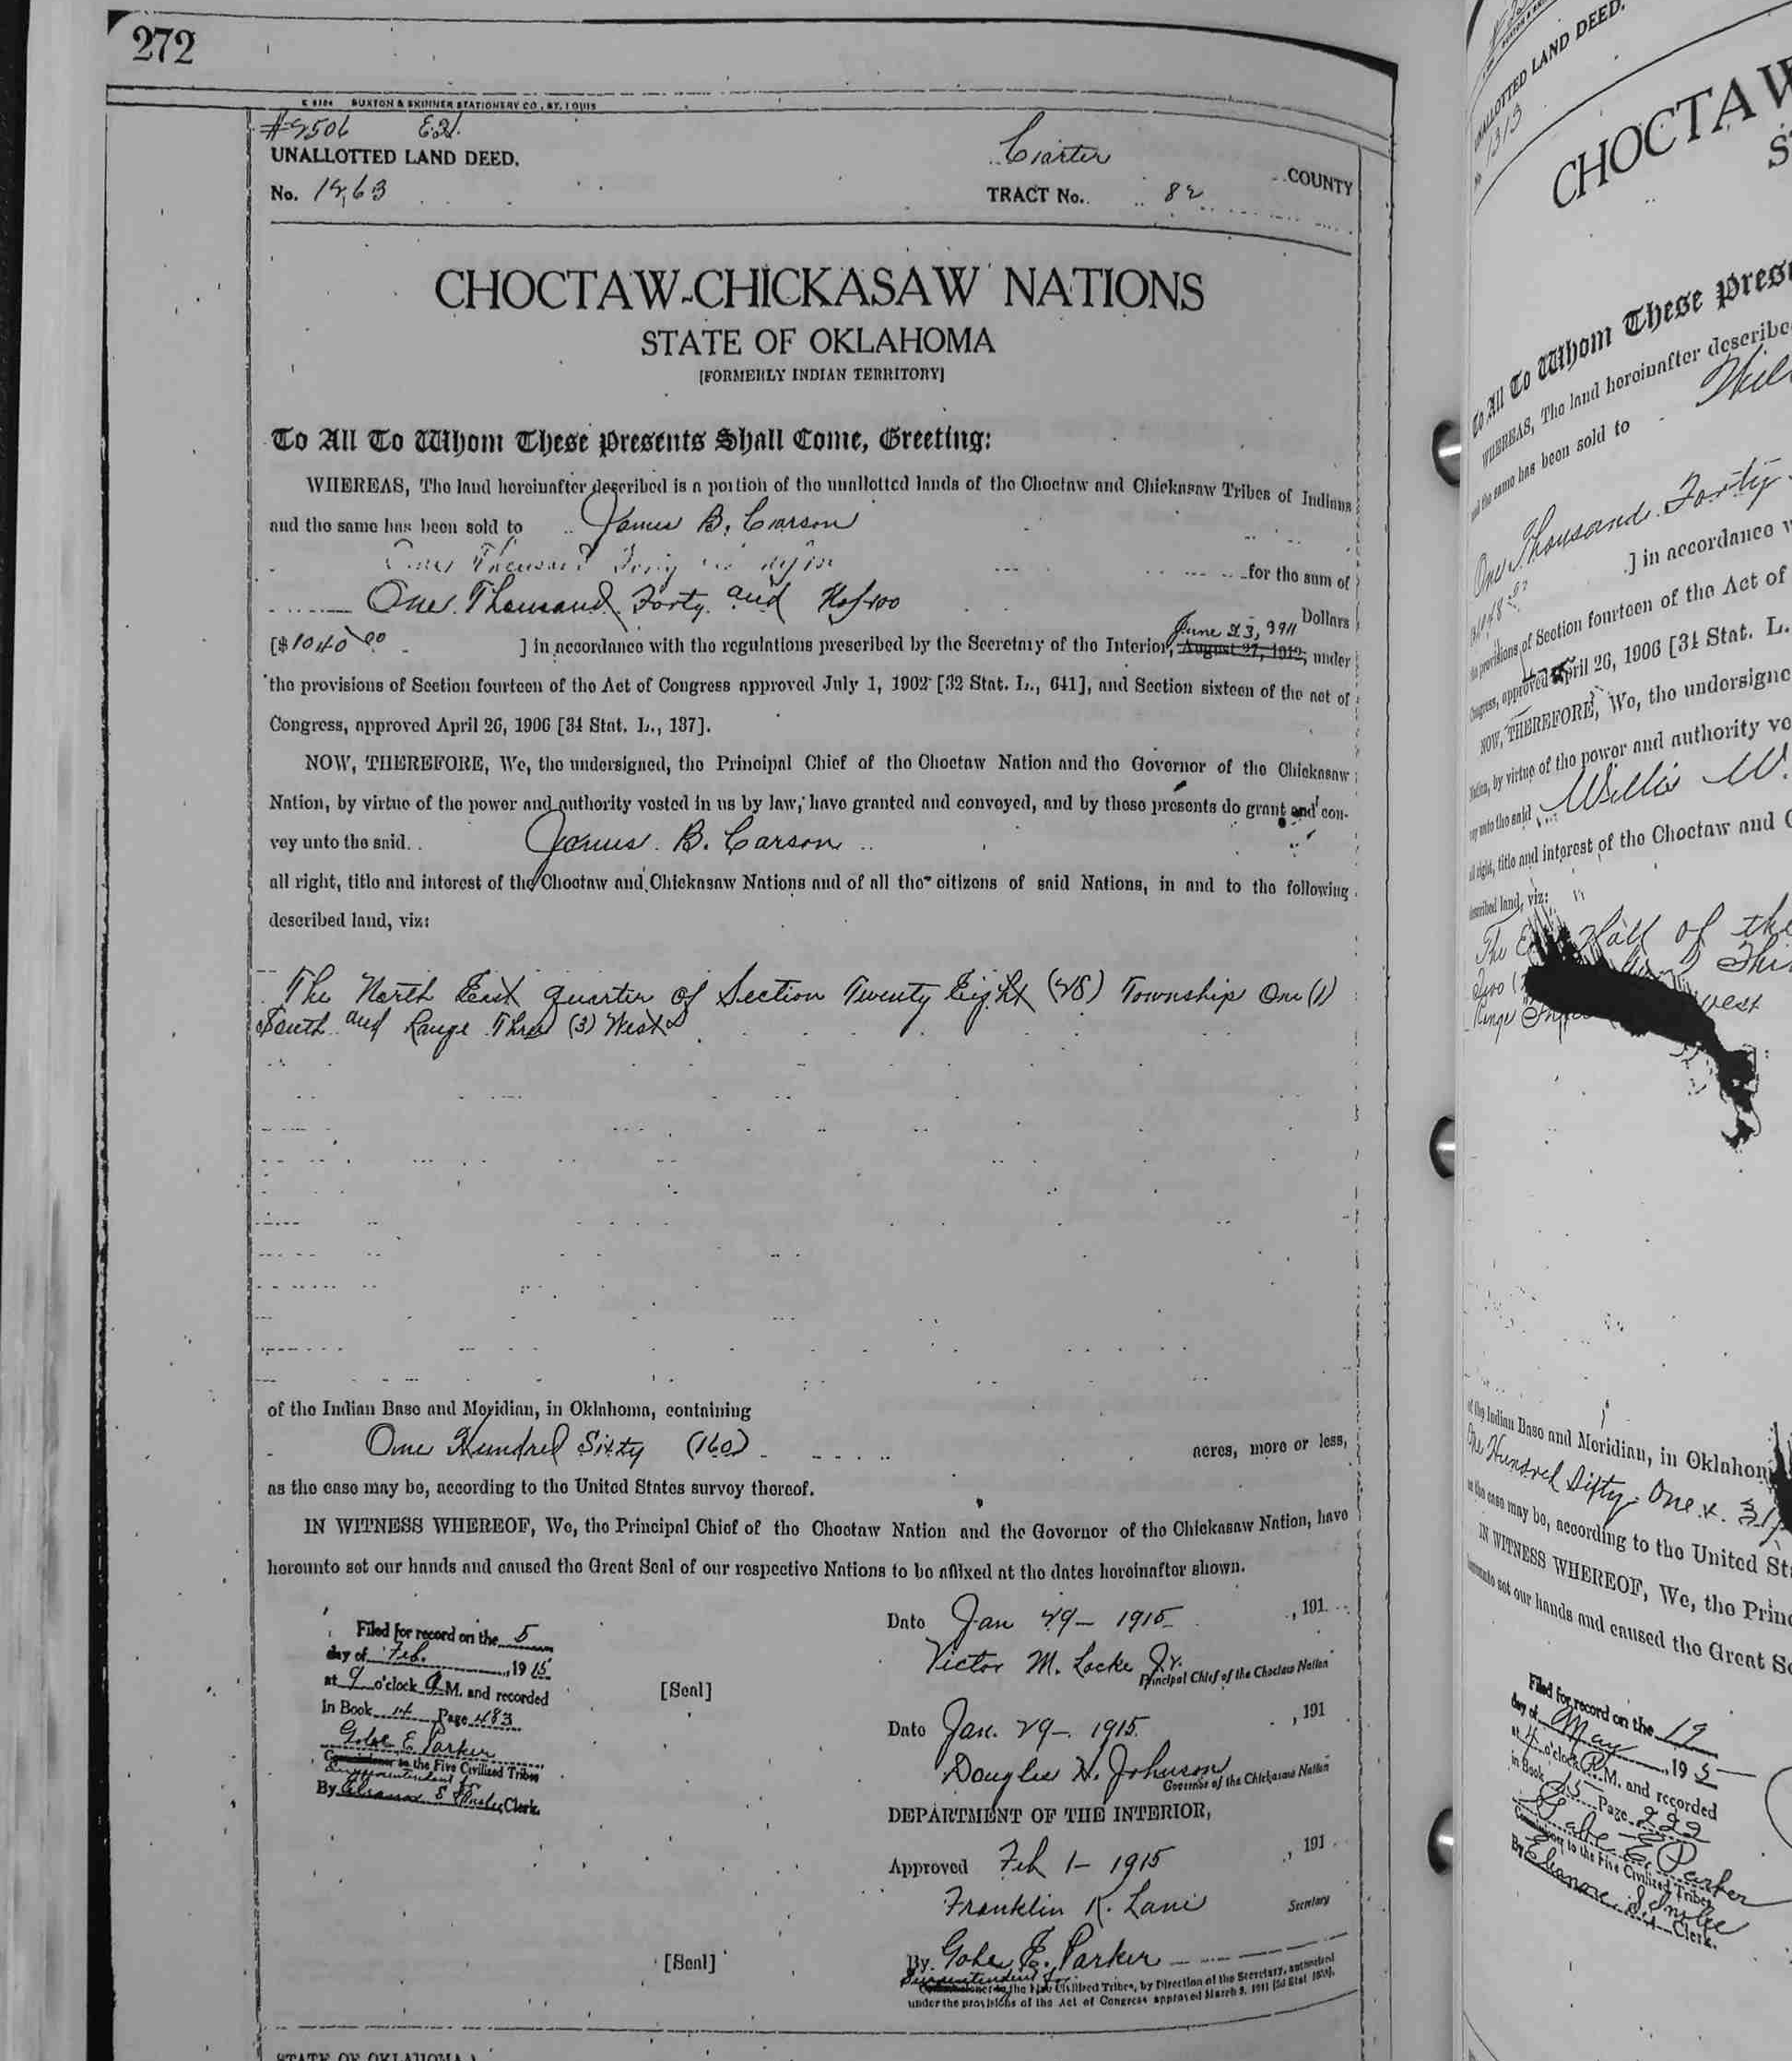
Historical Context
2018 Amendments: Land protection vs. fractionation surge
Parallel: Osage guardianship — intent vs. outcomes
Need: Balance preservation with economic viability
Notes:
The 2018 Stigler Act Amendments aimed to protect Five Tribes’ lands by extending restricted status to all descendants, but they’ve surged fractionation, echoing the Osage guardianship system of the 1920s.
That system sought to shield Osage wealth during the Reign of Terror, yet it often became a bureaucratic trap, stifling economic control and enabling loss—a protective intent undone by unintended burdens.
Today, the Heirs of Pope case mirrors this: a policy to preserve land has left owners with mineral interests too small to thrive, caught between heritage and practicality.
The buy-back program tackles such issues for General Allotment Act lands, but for the Five Tribes, it’s a square peg in a round hole.
State pooling, however, balances this tension—preserving restricted status while making fractionated interests economically viable.
This historical echo demands a modern solution, and pooling fits where federal consolidation doesn’t, ensuring the 2018 Amendments’ goals don’t falter like past Indian policies.
It’s a path to sustainability, —turning a burden into an opportunity, aligning past lessons with a forward-looking solution to shape a workable future for Oklahoma’s Indian lands.

Slide 27
Conclusion
Takeaways
  Fractionation erodes value (1.244 acres, $25 delays)
  Trust breaches persist (See Heirs of Pope allegations)
  Pooling restores equity, aligns with government Trust duty
Call to Action
  Reform restricted land management
Notes:
In summary, Heirs of Pope exposes fractionation’s toll.
The federal buy-back program fits for General Allotment Act lands, but for the Five Tribes’ Stigler Act lands, it’s a misfit.
State pooling steps in, restoring equity where federal consolidation can’t—sharing proceeds fairly, aligning with the trust duty via IIM accounts, and turning burdens into assets.
From Osage Wind’s surface lessons to Pope’s mineral interest woes, we see federal Indian policy’s schizophrenia, as Justice Thomas put it, demanding adaptive solutions.
Pooling offers that for the Five Tribes, balancing the 2018 Amendments’ preservation with economic reality.
Government and industry must reform restricted land management—embracing pooling to honor trust obligations and ensure viability for fractionated interests.
Thank you for joining me on this journey through Oklahoma’s Indian law updates.
Let’s keep pushing forward together.

Slide 28
A Fractured Land
Fractionation, it’s a lingering curse,
How the Dawes shadow grows ever worse,
From allotment to shards, the land’s carved thin,
A history scarred where greed crept in,
The leaders stand firm, their will outpour,
But the oil and gas, locked deep in the core,
Cry out for release, a silent plea,
From the government’s grip on the old Decree.
— L. Walker, 2025
Notes:
“I wrote this poem, ‘A Fractured Land,’ to express my thoughts on the challenges we face in our industry.”
A Fractured Land
Fractionation, it’s a lingering curse,
How the Dawes shadow grows ever worse,
From allotment to shards, the lands carved thin,
A history scarred where greed crept in,
The leaders stand firm, their will outpour,
But the oil and gas, locked deep in the core,
Cry out for release, a silent plea,
From the government’s grip on the old Decree.
— L . Walker, 2025

Slide 29

Thanks for attending!
Sign up for our newsletter and get exclusive access to
the latest OG content and top stories about oil & gas.
Oliva Gibbs

